Slide 1

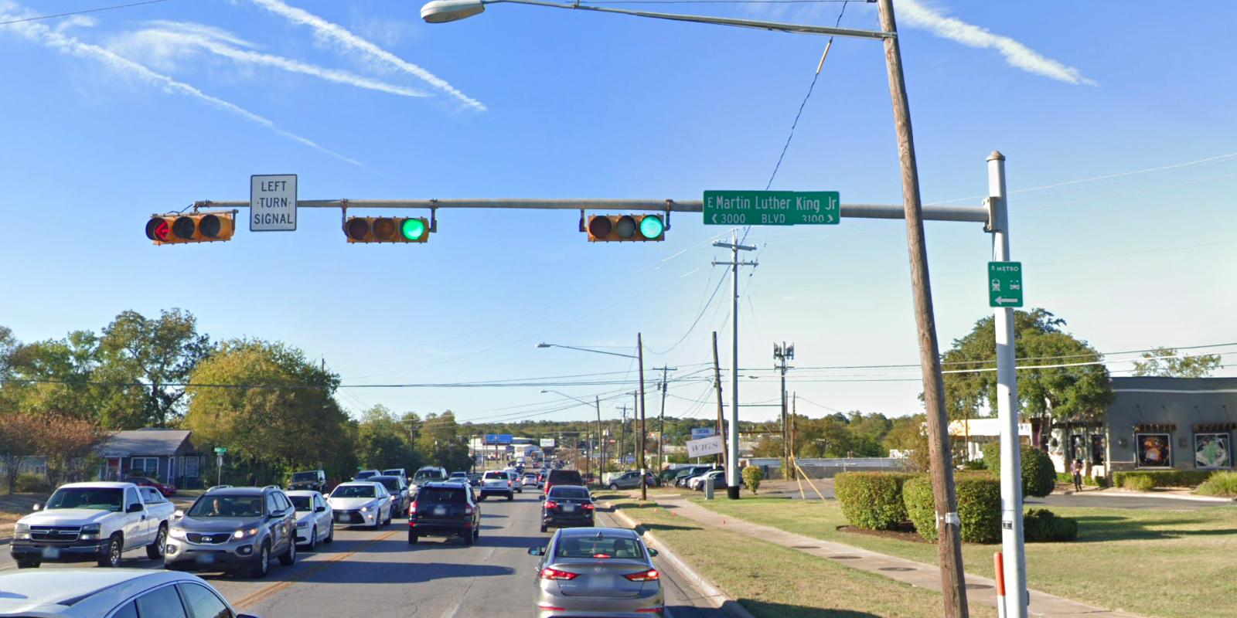
Austin Transportation Department Signs Work Orders
Created By: Susanne Gov Created Date: 2020-08-10 Location Name: AIRPORT BLVD / MARTIN LUTHER KING JR BLVD Intersection ID: 5161612 Cardinal Direction: N Work Order ID: SG-20164
Sign Type | Install/Remove
Street Name Sign | Install
Left Turn Signal | Install

Slide 2
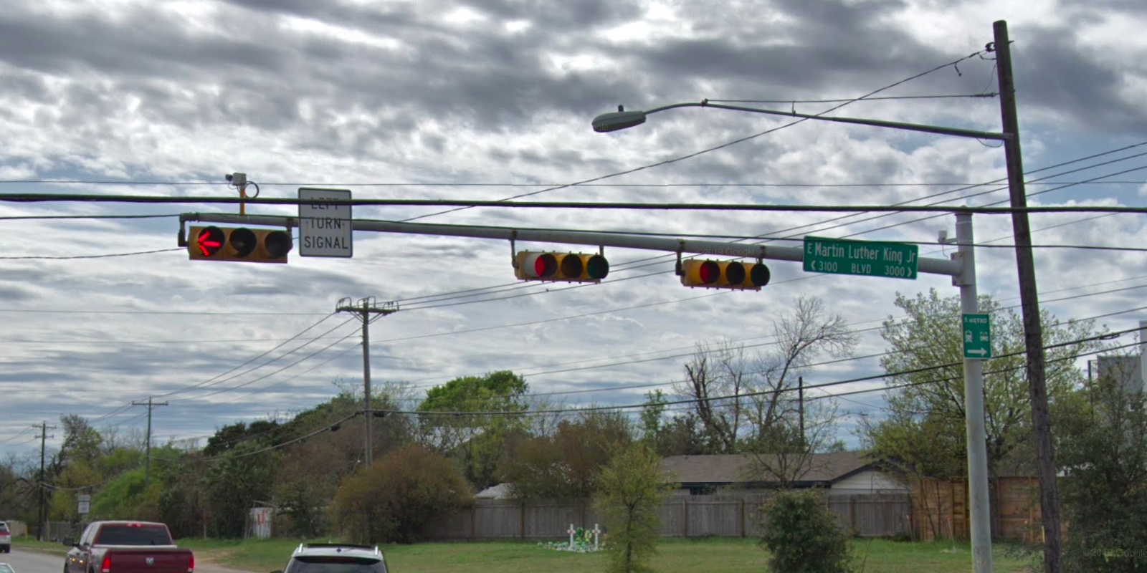
Austin Transportation Department Signs Work Orders
Created By: Susanne Gov Created Date: 2020-08-10 Location Name: AIRPORT BLVD / MARTIN LUTHER KING JR BLVD Intersection ID: 5161612 Cardinal Direction: S Work Order ID: SG-20164
Sign Type | Install/Remove
Street Name Sign | Install
Left Turn Signal | Install

Slide 3
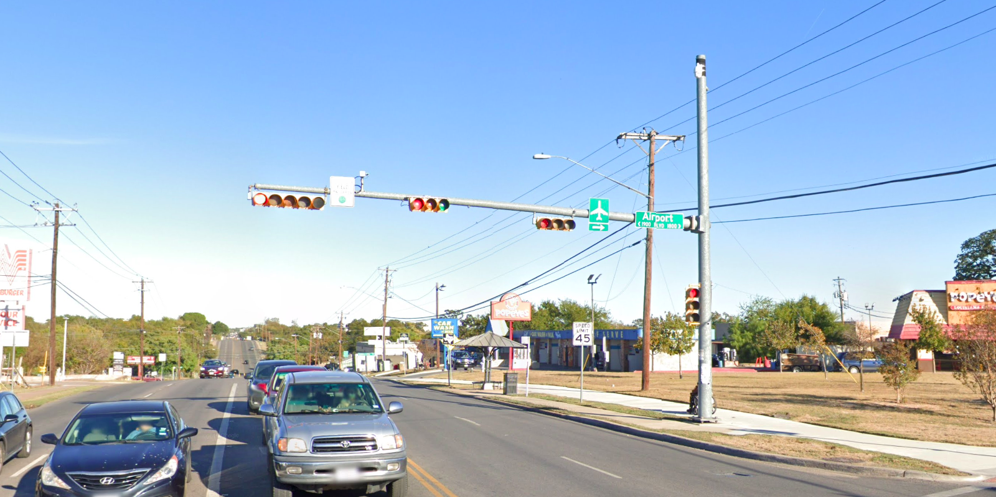
Austin Transportation Department Signs Work Orders
Created By: Susanne Gov Created Date: 2020-08-10 Location Name: AIRPORT BLVD / MARTIN LUTHER KING JR BLVD Intersection ID: 5161612 Cardinal Direction: E Work Order ID: SG-20164
Sign Type | Install/Remove
Left Turn Yield On Green | Install
Street Name Sign | Install
Airport Symbol | Install

Slide 4
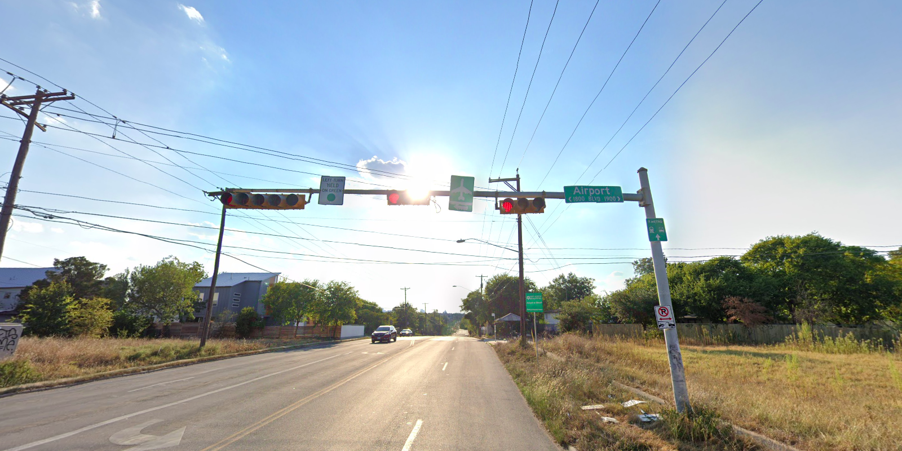
Austin Transportation Department Signs Work Orders
Created By: Susanne Gov Created Date: 2020-08-10 Location Name: AIRPORT BLVD / MARTIN LUTHER KING JR BLVD Intersection ID: 5161612 Cardinal Direction: W Work Order ID: SG-20164
Sign Type | Install/Remove
Left Turn Yield On Green | Install
Street Name Sign | Install
Airport Symbol | Install

